Slide 1

Exploring Uses of Multi-Party Aggregation on Shared Data and Databases

Slide 2


Current Process - Problems
Inefficient, Tedious, Vulnerable
Security Breaches
Manual Data Input
From Various Sources
Transaction Processes Lag
User Error
Centralized ABC Corp.
Database
Problem
Challenge
Data Privacy
Impact
Innovation
Feasibility
Conclusion
Notes:
Quick overview of the problem (what it is)
Manual input of financial transactions from various sources (ABC corp & its subsidiaries) so that one database can contain all the transactions
That database must be stored in a single company’s database during audits etc, which is very space consuming & vulnerable to security risks
Key parts of the problem that needed to be solved
3 essential problems -> inefficient, cumbersome, vulnerable

Slide 3
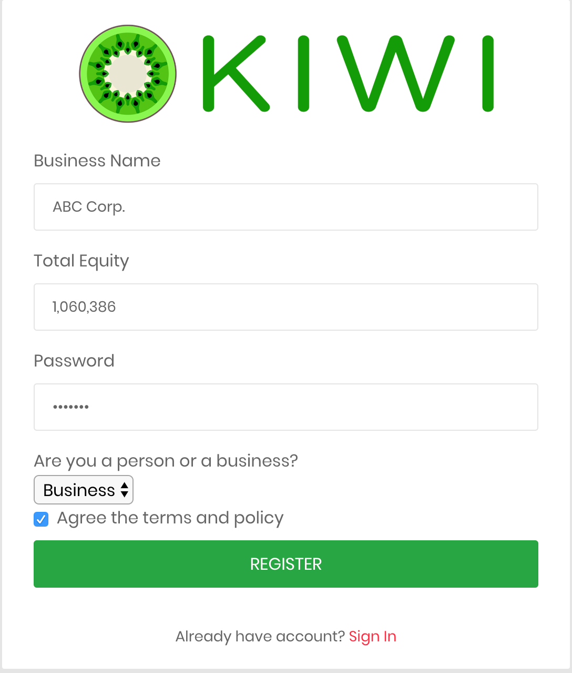
Proof Of Concept: Step 1
Summarizing the Approach
Setup Company Identity on the Blockchain
Notes:
Input company name, Company ID, CEO, Location, and Industry
This step adds all the employees, subsidiaries and their accounts and established them on the blockchain by uploading an excel file of the company’s information.
This is followed by uploading current balances which can be uploaded via an excel sheet

Slide 4
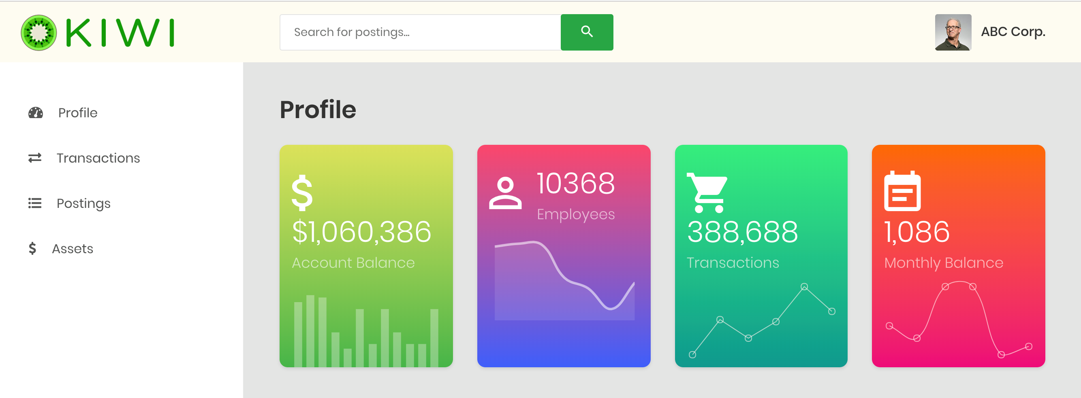
Proof Of Concept: Step 2
Summarizing the Approach
Notes:
Upload an excel file of the transactions which will then get processed onto the blockchain.
This not only adds the transaction info but also accounts for the changes made in the balances of the employees and companies that are transacting amongst each other.

Slide 5
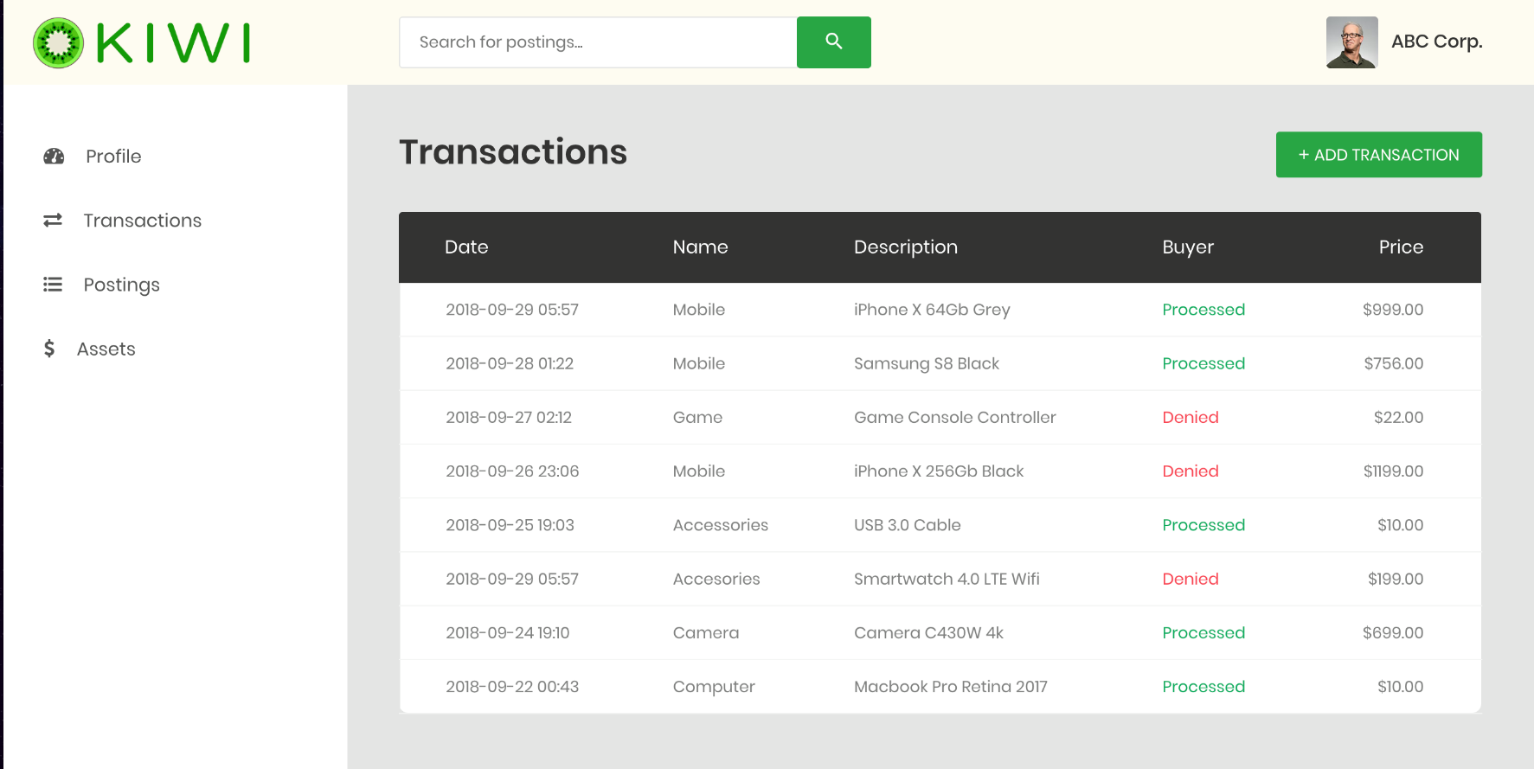
Proof Of Concept: Step 3
Summarizing the Approach
Visualize and Transact on the Blockchain
Notes:
Easily conduct transactions by:
Entering the account of the entity that is being sent from
Entering the account that is being sent to
a description of the transaction
Show live demo

Slide 6
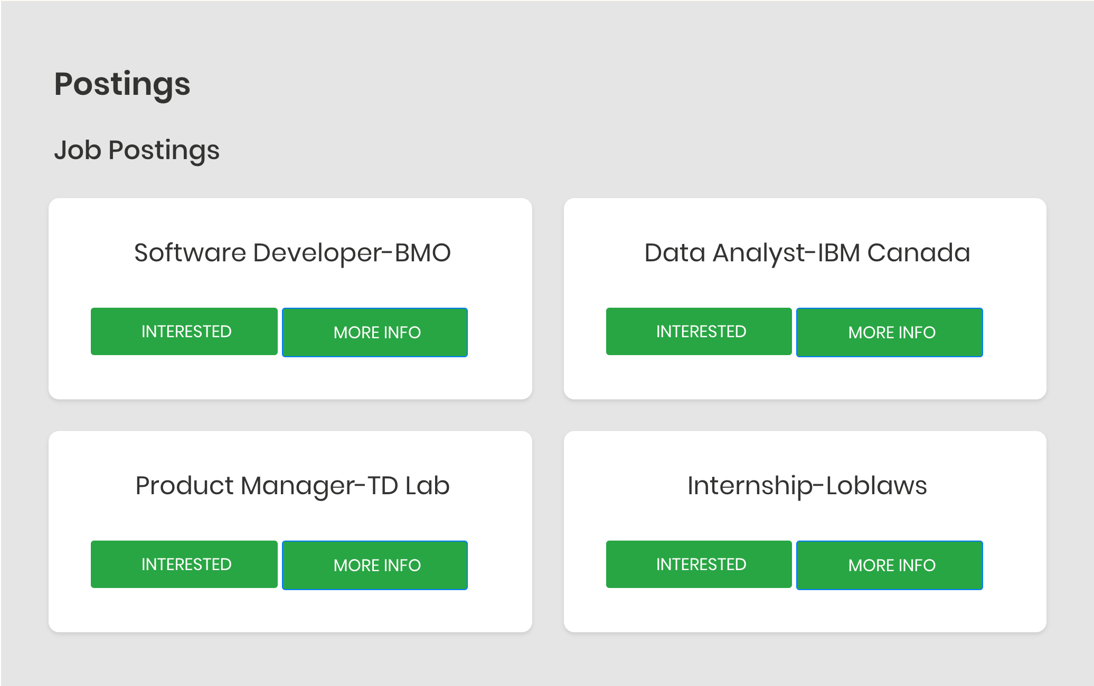
Proof Of Concept: Step 4
Summarizing the Approach
Platform for
Job Postings
Notes:
Easily conduct transactions by:
Entering the account of the entity that is being sent from
Entering the account that is being sent to
a description of the transaction
Show live demo

Slide 7
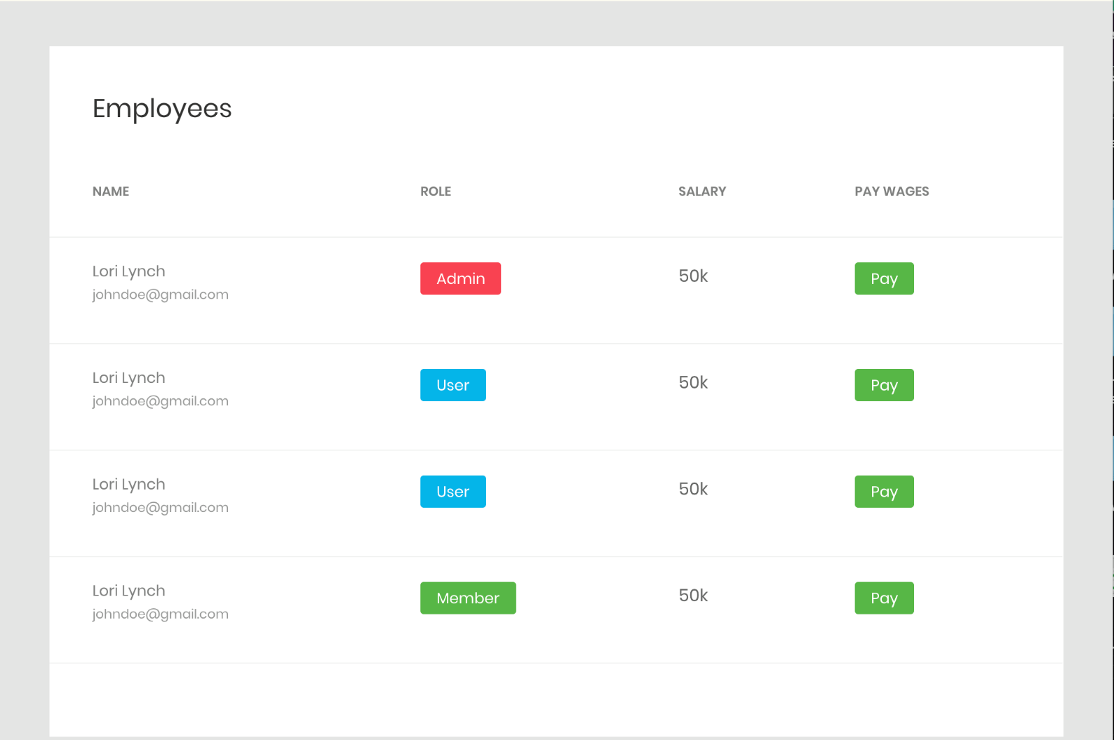
Proof Of Concept: Step 5
Summarizing the Approach
Display & Pay
Salaries of Employees
Notes:
Easily conduct transactions by:
Entering the account of the entity that is being sent from
Entering the account that is being sent to
a description of the transaction
Show live demo

Slide 8
Alignment with Challenge
A Solution that Goes Beyond the Needed Criteria
Meaningful
Consumer Interactions
Promotes
Local Economy
Increased
Security
Problem
Alignment
Data Privacy
Impact
Innovation
Feasibility
Conclusion

Slide 9
Data Privacy
Explorers: 100% Expect Blockchain Supports Enterprise Strategy
63
61
57
56
56
51
51
Increase Transactional Transparency
Ensure Data Quality and Accuracy
Increase Trust
in Transaction Reliability
Improve
Security
Against Fraud
Increase Transaction Speed
Reduce Transaction Costs
Simplify
Business Processes
Problem
Alignment
Data Privacy
Impact
Innovation
Feasibility
Conclusion
Notes:
At its core, blockchain is a shared ledger that allows participants in a business network to transact assets where everyone has control, but no one person is in control.” Leanne Kemp, Chief Executive Officer and Founder, Everledger, United Kingdom
Those who are currently implementing blockchain into their enterprise, i.e. explorers, find that Blockchain technology best supports their enterprise by creating more trust, transparency in both data and transactions Explorers: Those who are implementing blockchain Investigators: Those who are considering blockchain Passives: Not considering blockchain
Blockchains help build trust in several ways. The transparency of transactions establishes a traceable audit trail.
Smart contracts can encode the commitments between parties and help ensure they’re kept. Fm vmf

Slide 10
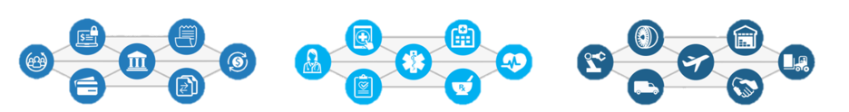
Shared Ledger Database
Secure Interaction Between Multiple Parties
Finance
Streamlined settlement,
improved liquidity, increased
transparency and new
products/markets
Healthcare
Unite disparate processes,
increase data flow and liquidity,
reduce costs and improve patient experience and outcomes
Supply Chain
Track parts and service
provenance, ensure authenticity
of goods, block counterfeits,
reduce conflicts
Problem
Alignment
Data Privacy
Impact
Innovation
Feasibility
Conclusion

Slide 11
Impact
Promoting Cashless Smart Economies
Performance
Market Share
Security
Problem
Alignment
Data Privacy
Impact
Innovation
Feasibility
Conclusion
Notes:
Forecast related issues & how it indirectly impacts market share & company output / performance
Affects Performance / Output: Consumes human labour & time, thus reduces company output and efficiency. Sacrificing innovation is an opportunity cost, as these resources can be reallocated to other projects that can push the company forward
Affects Market Share: majority of companies of this size have adapted blockchain & its benefits means ABC corp will fall behind the competition due to wasting resources
Affects Business Strategy: Cloud storage & IoT are predicted to be disrupted by blockchain which will directly affect ABC corp & its subsidiaries. Automation has been a long term trend & manual labour in technological industries does not align with company vision & strategy

Slide 12
Innovation
Meet Present Needs, Innovate Future Solutions to improve Torontonians lives and the smart economy
69% of businesses plan to replace current systems of record (e.g., financial ledgers, CRM, and ERP modules, inventory tracking systems, etc.) with blockchain – Deloitte’s 2018 global blockchain survey
Decentralized
Secure
Convenient
Problem
Alignment
Data Privacy
Impact
Innovation
Feasibility
Conclusion
Notes:
Visualize and transact on the blockchain

Slide 13
Feasibility
Consistent, Valuable and Positive Growth
Delivery
Delivery
Fully functional POC
Uniform Framework
Loss Aversion
Loss Aversion
Accountability
Duplicate Data
Security Breaches
Accountability
Transparency
Global Access
Problem
Alignment
Data Privacy
Impact
Innovation
Feasibility
Conclusion

Slide 14
“
Good to Great.
”
Problem
Alignment
Data Privacy
Impact
Innovation
Feasibility
Conclusion

Slide 15
Proof Of Concept
Demonstrating the Framework
Live Demo
Problem
Analysis
Recommendation
Proof of Concept
Pros & Cons
Predictions
Conclusion
Notes:
Demo:
Input the ABC company’s identification info
Upload their employee and subsidiary info in the form of an excel sheet.
Upload the transactions excel worksheet (2 minute delay to process all the transactions)
Show a visualization of the blockchain

Slide 16
Why Hyperledger Fabric?
Pros & Cons
Enterprise
Based
Open Source
Enhanced Privacy
Problem
Analysis
Recommendation
Proof of Concept
Pros & Cons
Predictions
Conclusion

